Slide 1


BA 305
Team 7
PREDICTING INSURANCE PRICES
Damian Grochowski, Ryan Whitehouse, Ole Nagorsen, Michael Lee, Reid Brock

Slide 2
Today’s Agenda
1
INTRODUCTION
DATASET
MODEL
4
MODEL RESULTS
FINDINGS
2
5
3

Slide 3
1.INTRODUCTION:
WHY WE NEED AN INSURANCE PRICING MODEL

Slide 4
A Prevailing Issue in American Healthcare
U.S. MEDICAL INSURANCE HAS BECOME A SIZABLE AND FREQUENT EXPENSE
COMPLICATED BILLING SYSTEMS CONFUSE PATIENTS ON THEIR INSURANCE CHARGES
PATIENTS DO NOT KNOW WHETHER THEY ARE BEING OVERCHARGED OR NOT
Americans owe over
$220,000,000,000
in medical debt
Consumer Financial Protection Bureau. 1 Oct. 2024. CFPB Takes Aim at Double Billing and Inflated Charges in Medical Debt Collection. https://www.consumerfinance.gov/about-us/newsroom/cfpb-takes-aim-at-double-billing-and-inflated-charges-in-medical-debt-collection/

Slide 5

OUR GOAL
To accurately predict a patient’s insurance costs given their personal profile in order to provide greater pricing clarity

Slide 6
2.OUR DATASET:
WHAT IT IS AND HOW WE USED IT

Slide 7
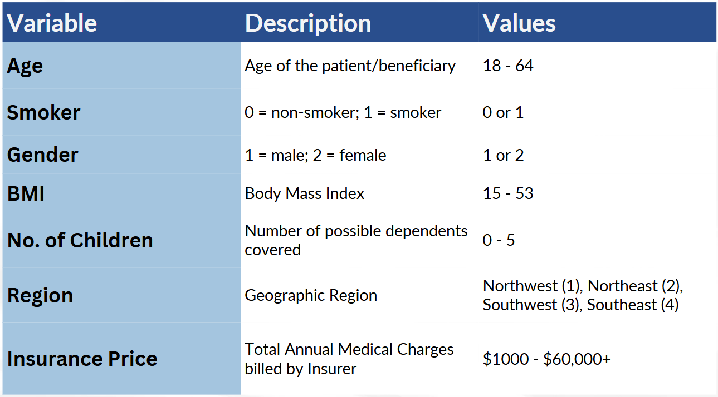
Final Dataset After Cleaning: 2,772 -> 2,761 Datapoints

Slide 8
Data Preprocessing
1
2
3
4
Converted smoker and gender variables into numeric binary values
Applied One-Hot encoding to convert regions into numeric binary value
Removed rows with missing/unknown values (?)
Verified data types

Slide 9

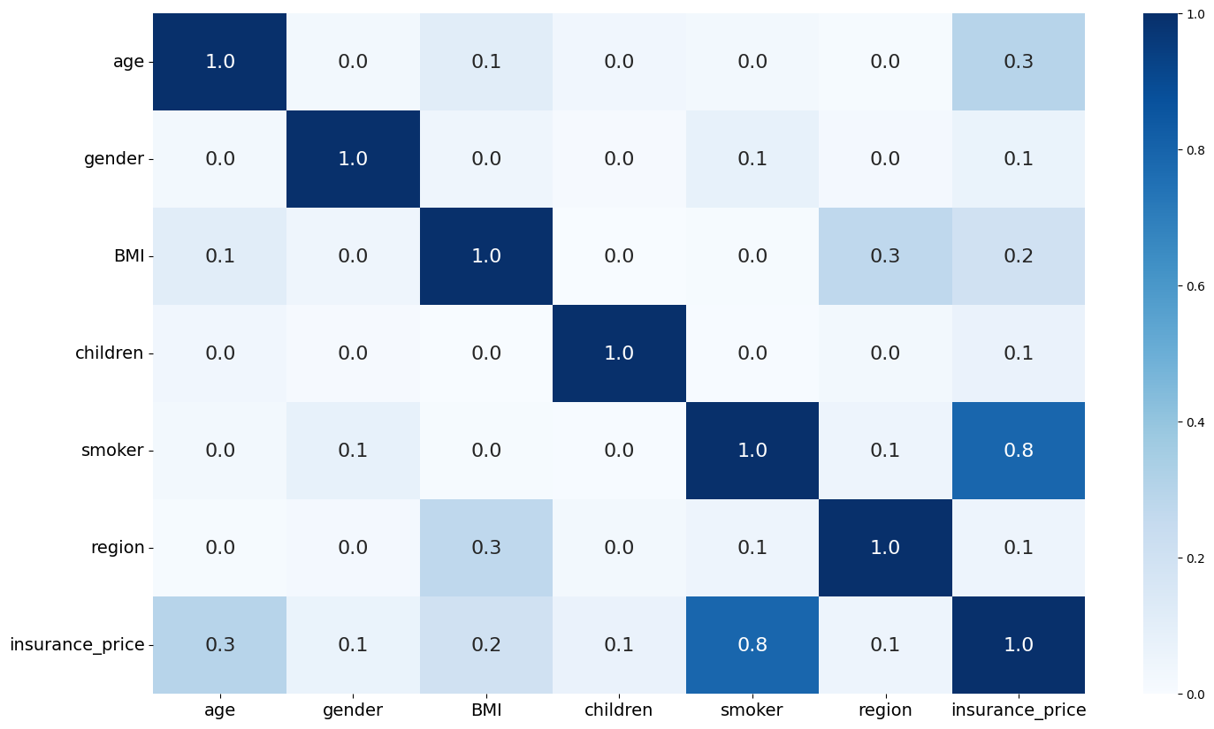
Initial Patterns in Our Data
Strong correlation between Smoking and Insurance Charges, followed by Age and BMI.

Slide 10
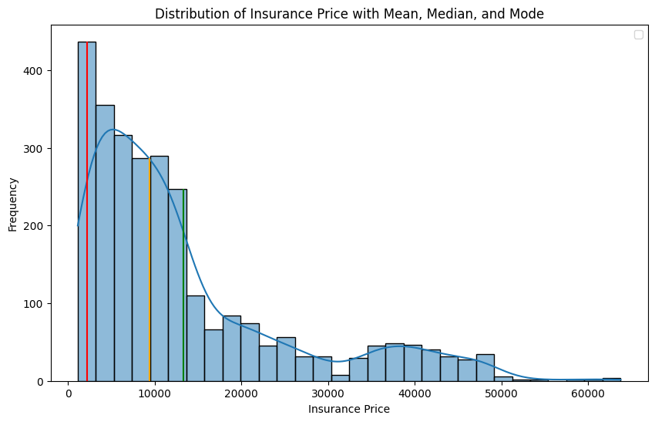
Our Dataset’s Averages
Key:
Mean: 13274.76
Median: 9377.90
Approx. Mode: 2166.02
Mean is pulled right/upward by extreme cases
Median reflect typical costs
Mode shows most common prices are low
Insurance Prices are not evenly distributed

Slide 11
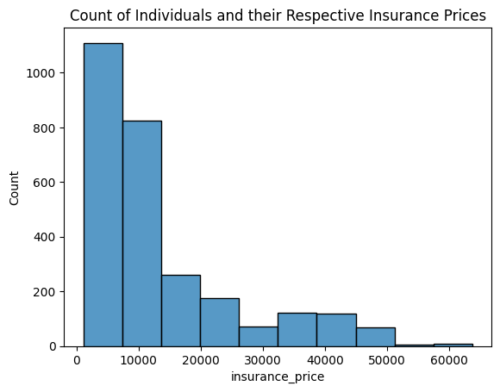
Addressing Extreme Insurance Price Cases
14 users experience costs over $50,000
ICU stays can exceed $4,300/day
Removing cases would distort the true distribution
“Critical Care Statistics,” Society of Critical Care Medicine (SCCM), accessed December 1, 2025, https://www.sccm.org/communications/critical-care-statistics.

Slide 12
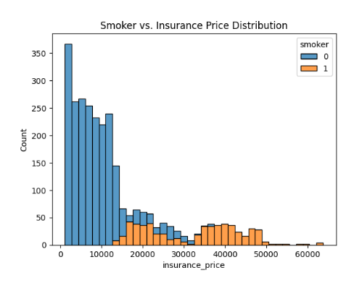
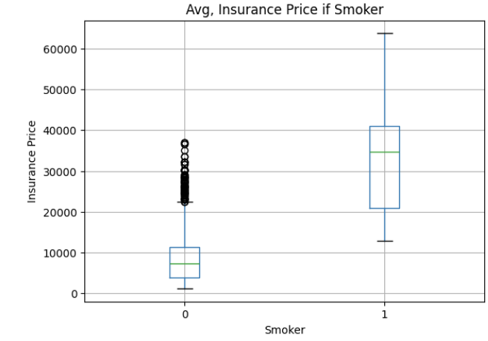
Initial Patterns in Our Data
Smokers incur higher and more variable costs compared to non-smokers, with extreme high cases pushing annual costs.

Slide 13
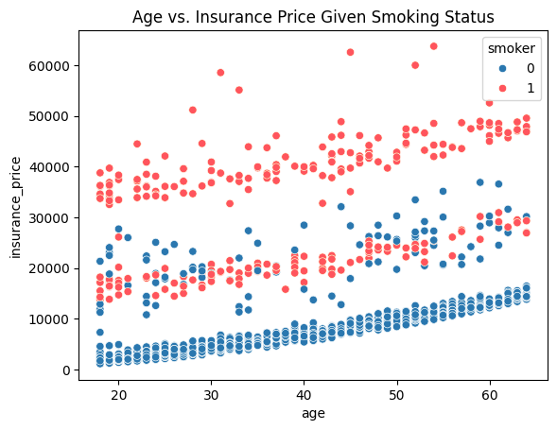
Abnormal Trends In Price
Notes:
man made machine -- man made lines

Slide 14
3.MODEL:
EXPLORATION AND POTENTIAL MODELS

Slide 15
Our Approach
Step 1:
Establish a baseline performance benchmark for all subsequent models
Step 2:
Introduce more complex, flexible models to capture relationships
Step 3:
Evaluate the models using same training and test split, tune hyperparameters of models, when feasible, and apply 5-fold cross validation
Step 4:
Comparison using MAE, RMSE and R-squared
Step 5:
Building and interpreting our two stage prediction algorithm
Notes:
Our approach for our model analyzation is establishing a baseline perfomrance, introducing complex and flexible models, evaluating using the same training and test split, tuning the hyperparameters and applying 5-fold cross validation
then we compared each model and built the two stage prediction algorithm

Slide 16
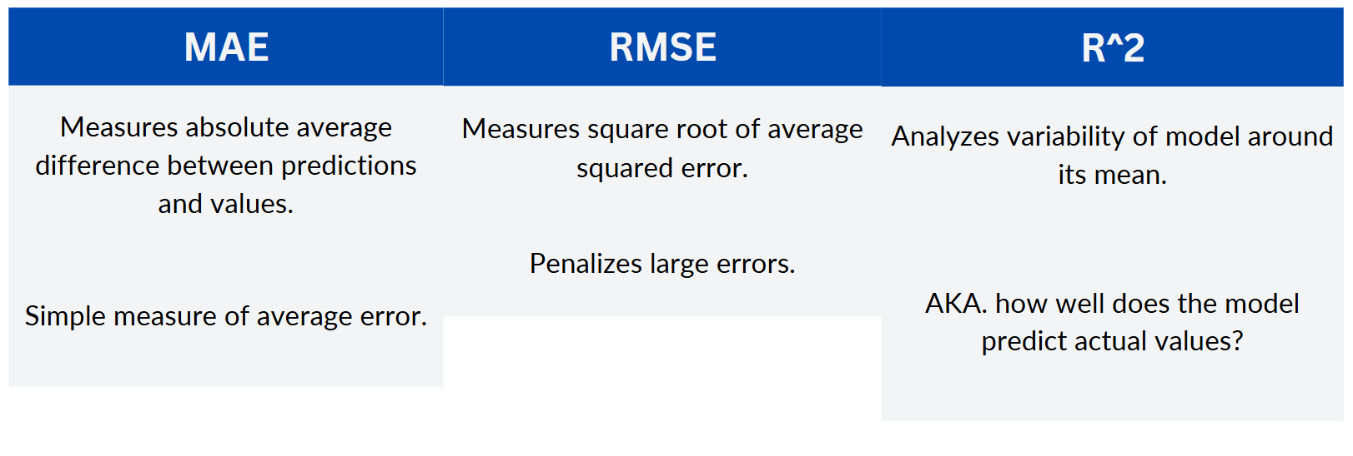
Comparison Criteria
BEST MODEL = CONSIDERS ALL THREE

Slide 17
Baseline Model
Naive Rule
Calculate by mean
MAE
9132.437
RMSE
12156.556
R^2
0.000 (Based on mean)

Slide 18
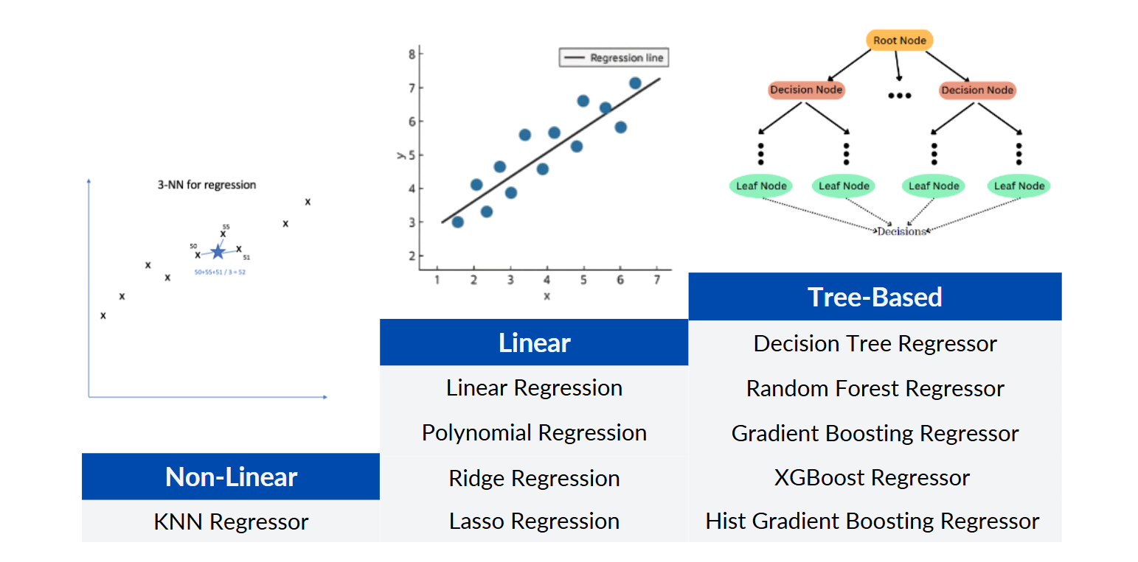
Models In Consideration

Slide 19
4.MODEL RESULTS:
THE BEST MODEL AND WHAT IT TELLS US

Slide 20
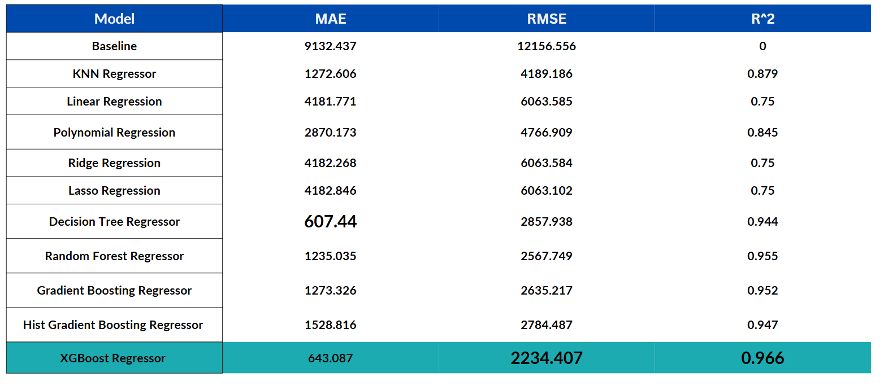
Performance Overview

Slide 21
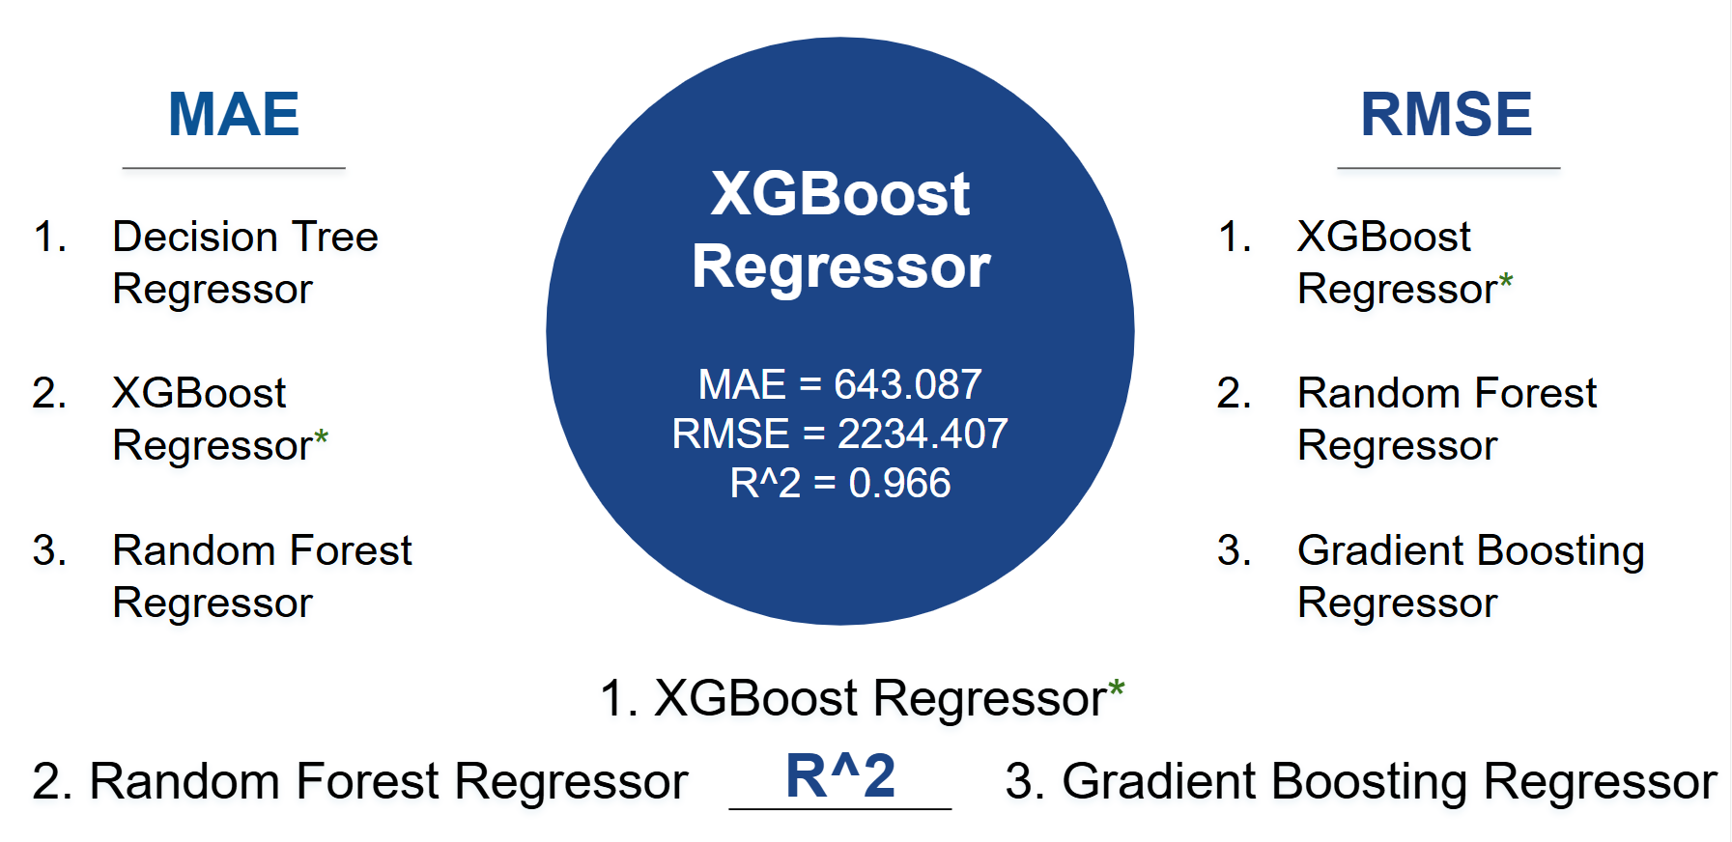
Performance Overview: Best Model

Slide 22
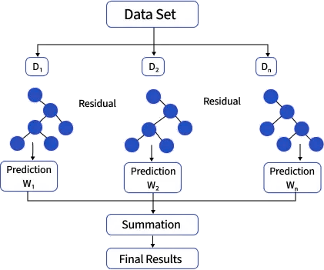
Model Interpretation: XGBoost
An ensemble model that sequentially creates decision trees derived from the errors of previous trees
Prunes trees backwards after reaching minimum depth to maximize gain and reduce chances of overfitting
Then factors in the predictions of all models together for a final decision
Notes:
Regularization: It includes built-in penalties (L1 and L2 regularization) in its objective function to prevent the model from overfitting the training data, helping it generalize better to new, unseen data.
Efficiency: It uses parallel processing to build the trees faster, effectively utilizing all the cores of your machine.
Missing Data Handling: The algorithm has a built-in routine to handle missing values automatically, which means you don't always need to perform complex data imputation beforehand.
Tree Pruning: It prunes trees backward after they've grown to a maximum depth, only keeping splits that provide a significant positive improvement (gain) to the model's performance, further preventing overfitting.
An ensemble model that sequentially creates decision trees derived from the errors of previous trees
which basically means that each time it creates a new tree it takes into consideration the results of the previous tree and uses that in its initial split, making it better and better
It is also amazingly complex and different abilities, such as pruning trees backwards after reaching maximum depth to maximize gain and reduce chances of overfitting

Slide 23
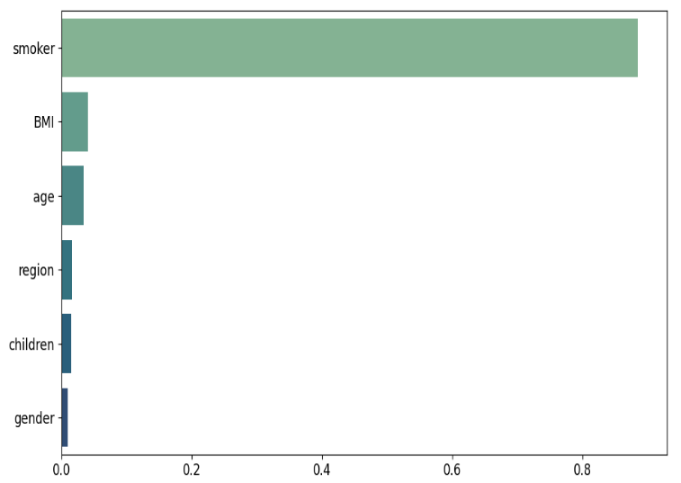
Model Interpretation: XGBoost
Most Important Features
Smoker - 88.85%
BMI - 4.05 %
Age - 3.43 %
Least Important Features
Region - 1.585 %
Children 1.49 %
Gender - 0.941 %
Why is Smoker so High?
Real Life: Smokers usually have drastically higher medical costs and premiums.
Model: XGBoost learns and builds more trees that split on Smoker first.
Warner, David O., Benjamin J. Borah, John Moriarty, David R. Schroeder, Yan Shi, and Nilay D. Shah. "Smoking Status and Health Care Costs in the Perioperative Period: A Population-Based Study." JAMA Surgery 149, no. 3 (March 2014): 259–266. https://doi.org/10.1001/jamasurg.2013.5009
Notes:
Let’s delve into the interpretation of our XGBoost model, focusing on the features that drive its decisions. [Pause briefly to emphasize the transition]
Firstly, the most important features: Smoker, BMI, and Age. These are the factors the model prioritizes when predicting outcomes. Notably, “Smoker” is the top feature. Why does it carry so much weight? In real life, smokers tend to incur significantly higher medical costs, which directly affects insurance premiums. XGBoost captures this by frequently splitting on the Smoker feature early in its decision trees. This prioritization enhances the model's accuracy.
Now, the least important features: Gender, Children, and Region. While these still play a role, their impact on predictions is less pronounced compared to the top features.
[Pause for reflection and engagement]
By understanding which features are most influential, we can better interpret and trust the model’s predictions. This insight is crucial for both developers and stakeholders who rely on model outputs to make informed decisions. [Conclude with a confident tone]

Slide 24
5.OUR FINDINGS:
APPLYING OUR MODEL AND WHAT PATIENTS CAN TAKE AWAY FROM THIS

Slide 25
Why Are Costs So High?
Why the Numbers Look High
Dataset reflects total medical insurance costs billed to beneficiaries
Explains why some individuals exceed $50,000 in annual charges
Average one-night stay at a U.S. hospital exceeds $3,000
Context From National Data
Avg. employer-sponsored premium (2024): $8,951 for single coverage
Smoking-related illnesses add over $100 Billion in direct U.S. healthcare costs annually
Kaiser Family Foundation. 2024. 2024 Employer Health Benefits Survey. Kaiser Family Foundation. https://www.kff.org/health-costs/2024-employer-health-benefits-survey/#3f3fc2dd-74dd-4cb6-9d1c-9c19ff972f6a
Warner, David O., Benjamin J. Borah, John Moriarty, David R. Schroeder, Yan Shi, and Nilay D. Shah. "Smoking Status and Health Care Costs in the Perioperative Period: A Population-Based Study." JAMA Surgery 149, no. 3 (March 2014): 259–266. https://doi.org/10.1001/jamasurg.2013.5009

Slide 26




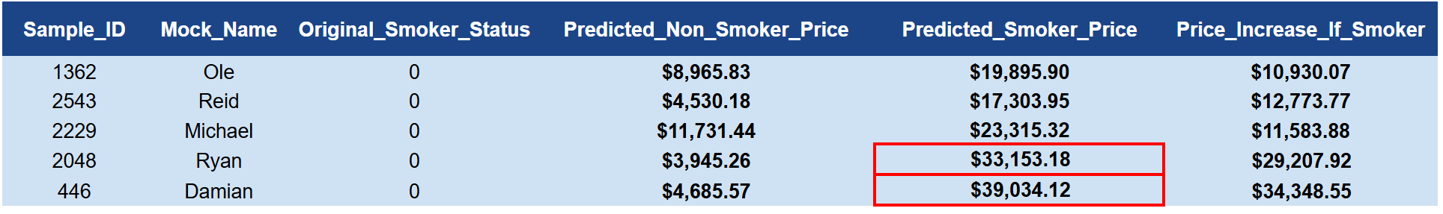
Dominant Driver in Insurance Costs
Smoking
Age
Obesity
The single strongest determinant of insurance price is smoking

Slide 27
Practical Applications of Our Model
1.
Consumers can input their own health characteristics to see an approximate cost.
If insurer quotes differ dramatically from model predictions, users can flag or investigate discrepancies.
Helps individuals anticipate future insurance expenses.
2.
3.

Slide 28


How This Will Help Consumers?
Transparency Into Cost Drivers
+
Actionable Health Insights
Clear Pricing Expectations
Better Decision-Making
Pricing Clarity
Health Impact

Slide 29
BONUS:
THE CUTTING ROOM FLOOR (AND POTENTIAL IMPROVEMENTS)

Slide 30
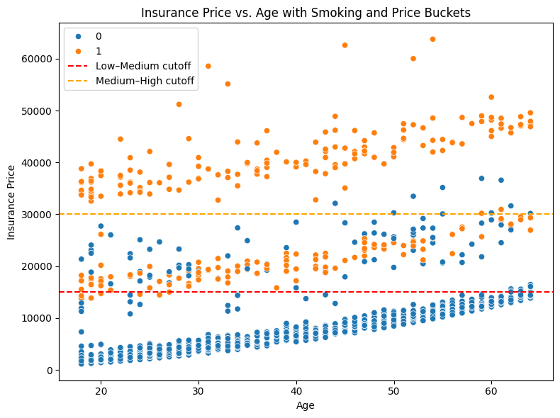
Two Stage Approach Classification into Regression
Classification: Random Forest
Regression: XGBoost
MAE: 1115
R^2: 0.876
Classification: Random Forest
Regression: XGBoost
R^2:
MAE:
C: High Price Class
$30K+, 339 Entries
B: Medium Price Class
$15K-$30K, 397 Entries
A: Low Price Class
$0-$15K, 2,025 Entries

Slide 31
Thank You!
Any Questions?

